Slide 1

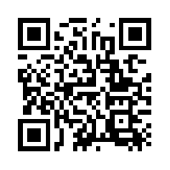
Quantum Communications Group
Weekly report
Group Coordinator:
Armando Nolasco Pinto
anp@ua.pt
Group Websites:
https://www.it.pt/Groups/Index/72
LinkedIn: https://www.linkedin.com/company/quantum-communications-group-it-av/

Slide 2
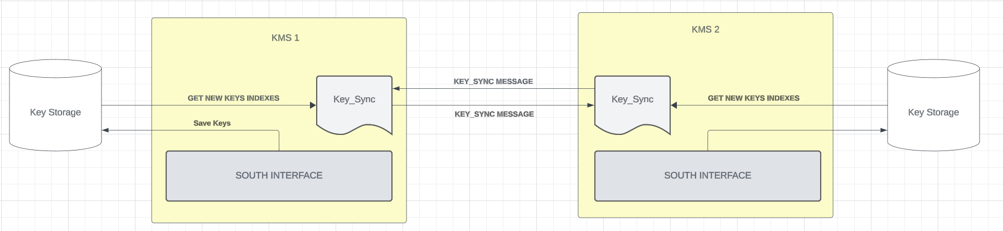
Key Synchronization Block
Key_Sync Message( URI &source, URI &destination, Status status, unsigned int index, QoS &qos){
{"command", "KEY_SYNC"}, {"data", { {"source", source}, {"destination", destination}, {"qos", { {"key_type", qos.key_type}, {"key_chunk_size", qos.key_chunk_size}, } }, }, }, {"status", status}, {"index", index},
};

Slide 3
Key Synchronization (creation of a key to send to the apps)
The message between KMS to sync the new keys that will be provided to the applications need to have the North Key Stream ID (session between KMS and APP), the index of the key material received that will be used and an hash.​
Notes:
The message between KMS to sync the new keys that will be provided to the applications need to have the North Key Stream ID (session between KMS and APP), the index of the key material received that will be used and an hash.

Slide 4
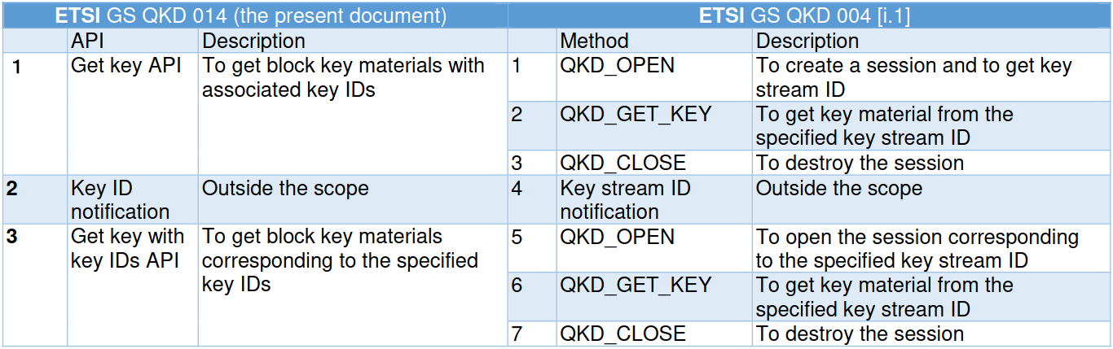
ETSI014 TO ETSI004
The mapping between ETSI004 and ETSI014 is done like in the table below, but we are not sure how we can do it.
Notes:
The mapping between ETSI004 and ETSI014 is done like in the table below, but we are not sure how we can do it.

